Slide 1
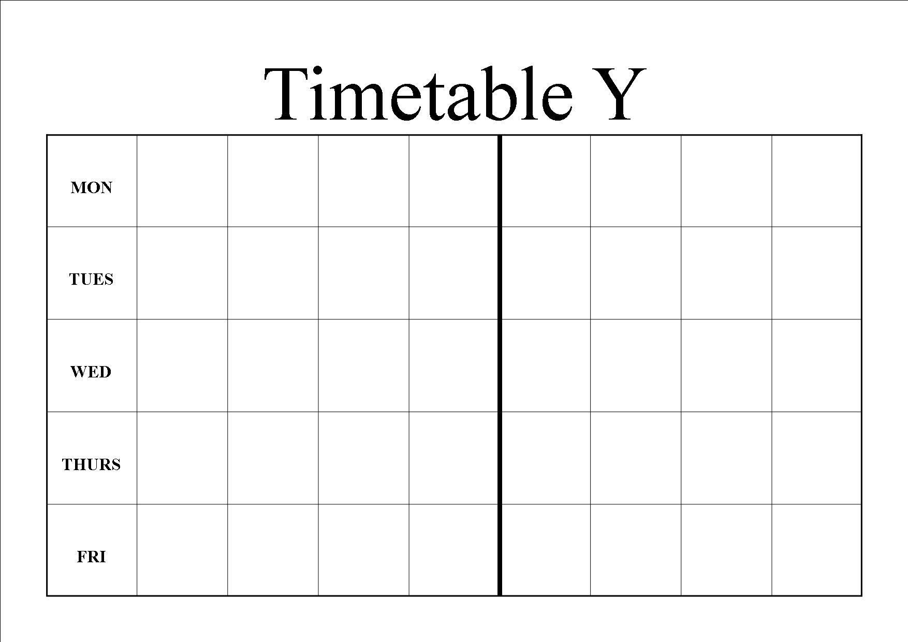
TimeTable
Group3: 贺镕翔、钟宇睿

Slide 2
Agenda
Overview
Selling Proposition
User groups
Marketing Channels
Conclusion
演示文稿标题

Slide 3
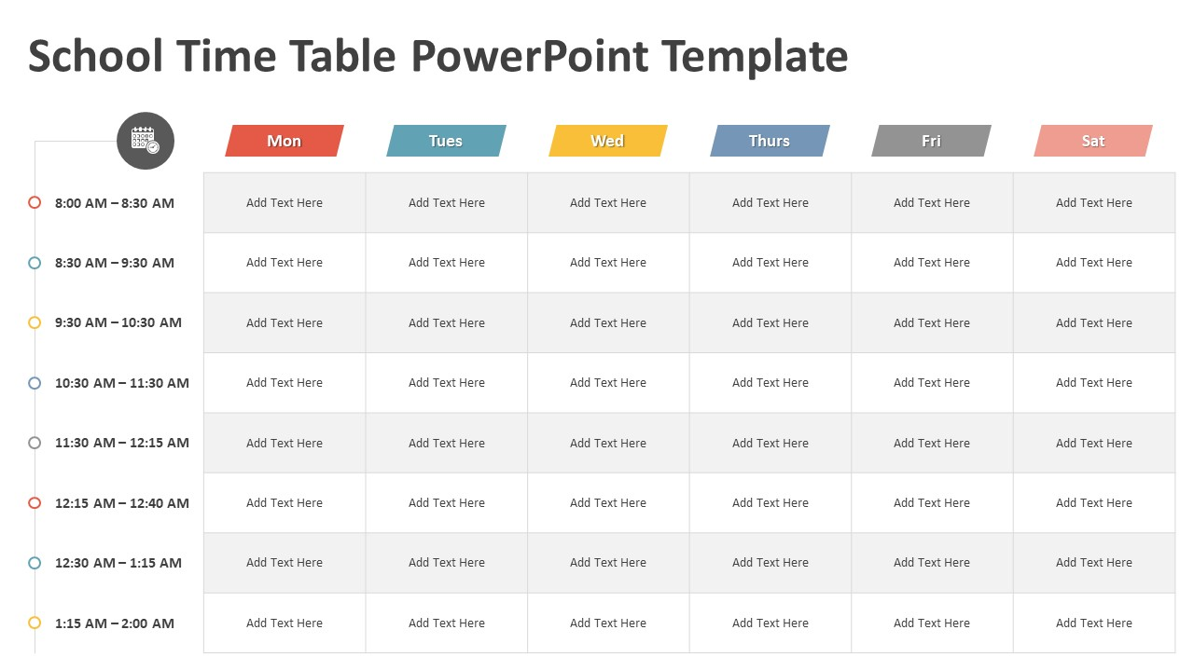
Overview
Project Name: TimeTable
Objective: To develop an intuitive and user-friendly scheduling app that helps users manage their daily tasks and appointments efficiently.
Platform: Android

Slide 4
User-Friendly Interface: A clean, intuitive design that is easy to navigate, with both light and dark modes.
Selling Proposition
Seamless Integration: Sync with popular calendar services like Google Calendar and Outlook.
Customizable Reminders: Users can set personalized reminders with various notification options.

Slide 5
User Groups
Primary Persona: Marketing Manager
Pain Points: Struggles with managing multiple meetings and deadlines, needs a reliable tool to keep track of tasks.
Goals: To stay organized, improve productivity, and ensure no tasks are missed.
Two main user groups:
Secondary Persona: University Student
Pain Points: Finds it challenging to balance study, part-time work, and social activities.
Goals: To manage time effectively, keep track of assignments, and maintain a balanced schedule.

Slide 6
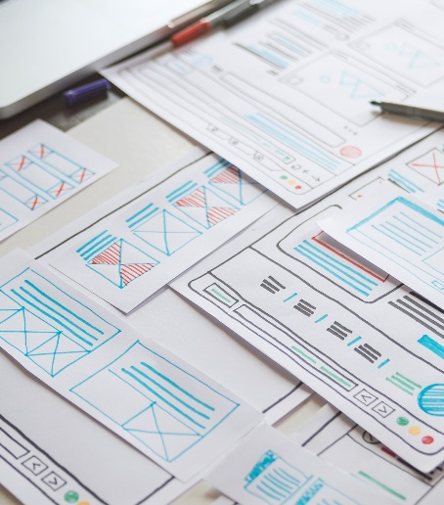
Marketing Channels
Social Media Advertising: Utilize platforms like Webo, Tiktok, and bilibili to reach potential users through targeted ads.
Content Marketing: Create blog posts, tutorials, and videos on productivity tips and how to use the app effectively.

Slide 7
Marketing Channels
App Store Optimization (ASO): Optimize the app listing on App Store with relevant keywords, engaging descriptions, and high-quality screenshots.
Email Marketing: Build an email list to send newsletters, updates, and promotional offers to users.
Referral Programs: Encourage existing users to refer the app to friends and colleagues by offering incentives.

Slide 8


The TimeTable app aims to provide a comprehensive and user-friendly solution for managing daily tasks and appointments. By leveraging seamless calendar integration, and customizable reminders, the app stands out with its unique selling propositions. With a clear development plan and targeted marketing strategy, TimeTable is poised to become an essential tool for anyone looking to enhance their productivity and time management.
Conclusion

